Slide 1
Performing Flashback Database

Slide 2
Objectives
After completing this lesson, you should be able to:
  Configure Flashback Database
  Perform Flashback Database operations
  Monitor Flashback Database
Notes:
Oracle Database 11g: Administration Workshop II 12 - <number>

Slide 3




Flashback Database
The Flashback Database operation:
  Works like a rewind button for the database
  Can be used in cases of logical data corruptions made by users
Errors are generated.
The database is corrupted.
"Press the rewind button"
(FLASHBACK DATABASE).
The database is "rewound."
Notes:
Oracle Database 11g: Administration Workshop II 12 - <number>
Flashback Database
With Flashback Database, you can quickly bring your database to an earlier point in time by undoing all the changes that have taken place since that time. This operation is fast because you do not need to restore backups. You can use this feature to undo changes that have resulted in logical data corruptions.
When you use Flashback Database, the Oracle database uses past block images to back out changes to the database. During normal database operation, the Oracle database occasionally logs these block images in flashback logs. Flashback logs are written sequentially and are not archived. The Oracle database automatically creates, deletes, and resizes flashback logs in the Fast Recovery Area. You need to be aware of flashback logs only for monitoring performance and deciding how much disk space to allocate for them in the Fast Recovery Area.
The time it takes to rewind a database with Flashback Database is proportional to how far back in time you need to go and the amount of database activity after the target time. The time it would take to restore and recover the whole database could be much longer. The before images in the flashback logs are used only to restore the database to a point in the past, and forward recovery is used to bring the database to a consistent state at some time in the past. The Oracle database returns data files to the previous point in time, but not auxiliary files, such as initialization parameter files. Flashback Database can also be used to compliment Data Guard and Recovery Advisor, and for synchronizing duplicated databases.

Slide 4
Flashback Database Architecture
SGA
Not every
change!
Redo log
buffer
Flashback
buffer
Buffer cache
Every
change
LGWR
Periodically log block-before images
Flashback
logs
Redo
logs
RVWR
Do forward media recovery.
Back out changes
to database using before images.
1
2
…
…
Notes:
Oracle Database 11g: Administration Workshop II 12 - <number>
Flashback Database Architecture
When you enable Flashback Database, the RVWR (Flashback Writer) background process is started. This background process sequentially writes Flashback Database data from the flashback buffer to the Flashback Database logs, which are circularly reused. Subsequently, when a FLASHBACK DATABASE command is issued, the flashback logs are used to restore to the blocks’ before images, and then redo data is used to roll forward to the desired flashback time.
The overhead of enabling Flashback Database depends on the read/write mix of the database workload. Because queries do not need to log any flashback data, the more write-intensive the workload, the higher the overhead of turning on Flashback Database.

Slide 5


Configuring Flashback Database
1. Configure the FRA.
2. Set the retention
target.
3. Enable Flashback Database.
If your database is in ARCHIVELOG mode, there is no need to restart it.
SQL> SHUTDOWN IMMEDIATE
SQL> STARTUP MOUNT
SQL> ALTER DATABASE ARCHIVELOG;
SQL> ALTER SYSTEM SET
2 DB_FLASHBACK_RETENTION_TARGET=2880 SCOPE=BOTH;
SQL> ALTER DATABASE FLASHBACK ON;
SQL> ALTER DATABASE OPEN;
With open database
Notes:
Oracle Database 11g: Administration Workshop II 12 - <number>
Configuring Flashback Database
You can configure Flashback Database as follows:
1. Configure the Fast Recovery Area.
2. Set the retention target with the DB_FLASHBACK_RETENTION_TARGET initialization parameter. You can specify an upper limit, in minutes, on how far back you want to be able to flash back the database. The example uses 2,880 minutes, which is equivalent to two days. This parameter is only a target and does not provide any guarantee. Your flashback time interval depends on how much flashback data has been kept in the Fast Recovery Area.
3. Enable Flashback Database with the following command:
ALTER DATABASE FLASHBACK ON;
Before you can issue the command to enable Flashback Database, the database must be configured for archiving.
You can determine whether Flashback Database is enabled with the following query:
SELECT flashback_on FROM v$database;
You can disable Flashback Database with the ALTER DATABASE FLASHBACK OFF command. As a result, all existing Flashback Database logs are deleted automatically.
Note: You can enable Flashback Database only when the database is mounted in exclusive mode, not open.

Slide 6
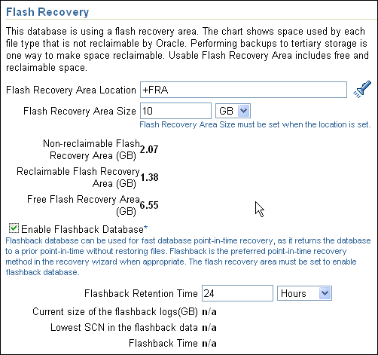
What You Need to Do
Configuration work flow:
1. Make sure that the database is in ARCHIVELOG mode.
2. Enable flashback logging and specify the Fast Recovery Area.
Notes:
Oracle Database 11g: Administration Workshop II 12 - <number>
What You Need to Do
Log in to Enterprise Manager (EM). On the Availability page, select Recovery Settings in the Backup/Recovery region. Make sure that your database is in ARCHIVELOG mode. If not, select ARCHIVELOG Mode and then click Continue. You need to shut down and restart the instance for your changes to take effect.
When the Fast Recovery Area and archiving are configured, USE_DB_RECOVERY_FILE_DEST is configured for archive log destination 10. Enable flashback logging by selecting Enable Flashback Logging. You can also set the flashback retention time and view important information regarding your flashback database window.
Review the Fast Recovery Area location. The Fast Recovery Area is a unified storage location for all recovery-related files and activities in an Oracle database. All files that are needed to completely recover a database from a media failure are part of the Fast Recovery Area. The recovery-related files that can be created in the Fast Recovery Area include: archived redo log files, control files, backups created by Recovery Manager (RMAN), flashback logs, and the change tracking file. By allocating a storage location and unifying recovery-related files within a specific area, the Oracle database server relieves the database administrator from having to manage the disk files created by these components. The default location for the Fast Recovery Area is $ORACLE_BASE/flash_recovery_area. If you would like it in a different location, change it now. Scroll down to the bottom of the Recovery Settings page and click Apply.

Slide 7
Flashback Database: Examples
  To flash back: Mounted (in exclusive mode) database
RMAN> FLASHBACK DATABASE TO TIME =
2> "TO_DATE('2009-05-27 16:00:00',
3> 'YYYY-MM-DD HH24:MI:SS')";
RMAN> FLASHBACK DATABASE TO SCN=23565;
RMAN> FLASHBACK DATABASE
2> TO SEQUENCE=223 THREAD=1;
Monitor progress of Flashback Database with the V$SESSION_LONGOPS view.
SQL> FLASHBACK DATABASE
2 TO TIMESTAMP(SYSDATE-1/24);
SQL> FLASHBACK DATABASE TO SCN 53943;
SQL> FLASHBACK DATABASE TO RESTORE POINT b4_load;
  To review changes: Read-only opened database
  To finalize: Read/write opened database with RESETLOGS
Notes:
Oracle Database 11g: Administration Workshop II 12 - <number>
Flashback Database: Examples
You can use the RMAN FLASHBACK DATABASE command to execute the Flashback Database operation. You can use SEQUENCE and THREAD to specify a redo log sequence number and thread as a lower limit. RMAN selects only files that can be used to flash back to, but not including, the specified sequence number.
Alternatively, you can use the SQL FLASHBACK DATABASE command to return the database to a past time or SCN. If you use the TO SCN clause, you must provide a number. If you specify TO TIMESTAMP, you must provide a time stamp value. You can also specify a restore point name.
You can monitor the Flashback Database progress with the V$SESSION_LONGOPS view.
Note: The database must be mounted in exclusive mode to issue the FLASHBACK DATABASE command and opened read-only to review changes. The database must be opened read/write with the RESETLOGS option when finished.

Slide 8
Flashback Database Considerations
  When the Flashback Database operation completes, open the database:
    In read-only mode to verify that the correct target time or SCN was used
    With a RESETLOGS operation to allow DML
  The opposite of “flash back” is “recover.”
  You cannot use Flashback Database in the following situations:
    The control file has been restored or re-created.
    A tablespace has been dropped.
    A data file has been reduced in size.
  Use the TO BEFORE RESETLOGS clause to flash back to before the last RESETLOGS operation.
Notes:
Oracle Database 11g: Administration Workshop II 12 - <number>
Flashback Database Considerations
In situations where you cannot use the Flashback Database feature, you should use an incomplete recovery operation to return the database to a specific time. After the Flashback Database operation is complete, you can open the database in read-only mode to verify that the correct target time or SCN was used. If not, you can flash back the database again, or perform a recovery to roll forward the database. So, to undo a Flashback Database operation, you should recover the database forward.
You cannot use Flashback Database to recover a data file that was dropped during the span of time you are flashing back. The dropped data file is added to the control file and marked offline, but it is not flashed back. Flashback Database cannot flash back a data file to a time after its creation and before the resize operation. If a file was resized during the span of time to which you are going to flash back the database, then you should take the file offline before beginning the Flashback Database operation. This is applicable for files that are shrunk rather than expanded. You can use Flashback Database with data files that you have configured for automatic extension. You can flash back to just before the last RESETLOGS operation by supplying the TO BEFORE RESETLOGS clause in the FLASHBACK DATABASE command.
Note: The flashback retention target is not an absolute guarantee that flashback will be available. If space is needed for required files in the Fast Recovery Area, flashback logs may be deleted automatically.

Slide 9
Monitoring Flashback Database
To monitor the ability to meet your retention target:
  View the Fast Recovery Area disk quota:
  Determine the current flashback window:
  Monitor logging in the Flashback Database logs:
SQL> SELECT estimated_flashback_size,
2 flashback_size
3 FROM V$FLASHBACK_DATABASE_LOG;
SQL> SELECT oldest_flashback_scn,
2 oldest_flashback_time
3 FROM V$FLASHBACK_DATABASE_LOG;
SQL> SELECT *
2 FROM V$FLASHBACK_DATABASE_STAT;
Notes:
Oracle Database 11g: Administration Workshop II 12 - <number>
Monitoring Flashback Database
It is important for you to monitor space usage of the Fast Recovery Area so that you know how well you are meeting your retention target. Use the V$FLASHBACK_DATABASE_LOG view to monitor the Flashback Database retention target:
ESTIMATED_FLASHBACK_SIZE uses previously logged flashback data to provide an estimate of how much disk space is needed in the Fast Recovery Area for flashback logs to meet the current flashback retention target. The estimate is based on the workload since the instance was started, or during the most recent time interval equal to the flashback retention target, whichever is shorter.
FLASHBACK_SIZE gives you the current size, in bytes, of the flashback data.
OLDEST_FLASHBACK_SCN and OLDEST_FLASHBACK_TIME display the approximate lowest SCN and time to which you can flash back your database. CURRENT_SCN in V$DATABASE gives you the current database SCN.
Use the V$FLASHBACK_DATABASE_STAT view to monitor the overhead of logging flashback data in the Flashback Database logs. This view contains 24 hours of information, with each row representing a one-hour time interval. You can use this view to determine rate changes in the flashback data generation.
SQL> SELECT begin_time, end_time, flashback_data, db_data,
2 redo_data, estimated_flashback_size AS EST_FB_SZE
3 FROM V$FLASHBACK_DATABASE_STAT;

Slide 10
Notes:
Oracle Database 11g: Administration Workshop II 12 - <number>
Monitoring Flashback Database (continued)
BEGIN_TIM END_TIME FLASHBACK_DATA DB_DATA REDO_DATA EST_FB_SZE
--------- --------- -------------- ---------- ---------- ----------
12-FEB-09 12-FEB-09 16384 0 24576 0
12-FEB-09 12-FEB-09 6594560 7471104 1533440 815923200
12-FEB-09 12-FEB-09 17235968 12361728 5150920 839467008
12-FEB-09 12-FEB-09 311648256 37249024 10272768 855195648
Based on this information, you may need to adjust the retention time or the Fast Recovery Area size.
FLASHBACK_DATA and REDO_DATA represent the number of bytes of flashback data and redo data written, respectively, during the time interval, and DB_DATA gives the number of bytes of data blocks read and written. This view also contains the estimated flashback space needed for the interval.
You can query V$RECOVERY_FILE_DEST to view information regarding the Fast Recovery Area. The column descriptions are:
NAME: Fast Recovery Area name, indicating location string
SPACE_LIMIT: Disk limit specified in the DB_RECOVERY_FILE_DEST_SIZE parameter
SPACE_USED: Space used by Fast Recovery Area files (in bytes)
SPACE_RECLAIMABLE: Amount of space that can be reclaimed by deleting obsolete, redundant, and other low-priority files through the space management algorithm
NUMBER_OF_FILES: Number of files
SQL> SELECT name, space_limit AS quota,
2 space_used AS used,
3 space_reclaimable AS reclaimable,
4 number_of_files AS files
5 FROM v$recovery_file_dest ;
NAME QUOTA USED RECLAIMABLE FILES
------------------------ ---------- ---------- ----------- -----
/u01/flash_recovery_area 5368707120 2507809104 203386880 226

Slide 11
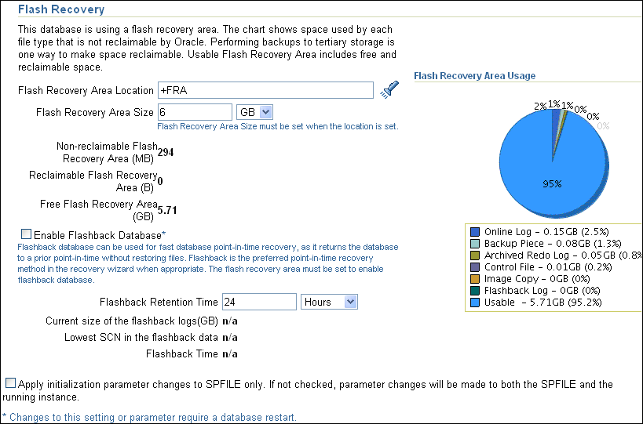
Monitoring Flashback Database with EM
Notes:
Oracle Database 11g: Administration Workshop II 12 - <number>
Monitoring Flashback Database with EM
Most of the Flashback Database statistics mentioned on the preceding pages can be viewed from the Recovery Settings page. These metrics include the current space used by all flashback logs, the lowest SCN, and the time of the lowest SCN in the flashback data.

Slide 12


Guaranteed Restore Points
A guaranteed restore point ensures that you can perform a FLASHBACK DATABASE command to that SCN at any time.
SQL> CREATE RESTORE POINT before_upgrade
2 GUARANTEE FLASHBACK DATABASE;
Notes:
Oracle Database 11g: Administration Workshop II 12 - <number>
Guaranteed Restore Points
Like normal restore points, guaranteed restore points can be used as aliases for SCNs in recovery operations. A principal difference is that guaranteed restore points never age out of the control file and must be explicitly dropped. However, they also provide specific functionality related to the use of the Flashback Database feature.
Creating a guaranteed restore point at a particular SCN enforces the requirement that you can perform a Flashback Database operation to return your database to its state at that SCN, even if flashback logging is not enabled for your database. If flashback logging is enabled, creating a guaranteed restore point enforces the retention of flashback logs required for Flashback Database back to any point in time after the creation of the earliest guaranteed restore point.
A guaranteed restore point can be used to revert a whole database to a known good state days or weeks ago, as long as there is enough disk space in the Fast Recovery Area to store the needed logs. As with normal restore points, guaranteed restore points can be used to specify a point in time for RECOVER DATABASE operations.
Note: Limitations that apply to Flashback Database also apply to guaranteed restore points. For example, shrinking a data file or dropping a tablespace can prevent flashing back the affected data files to the guaranteed restore point.

Slide 13
Flashback Database and
Guaranteed Restore Points
To use guaranteed restore points, the database must satisfy the following prerequisites:
  The COMPATIBLE initialization parameter must be set to 10.2 or greater.
  The database must be running in ARCHIVELOG mode.
  FLASHBACK DATABASE requires the use of archived redo logs starting from around the time of the restore point.
  A Fast Recovery Area must be configured.
Notes:
Oracle Database 11g: Administration Workshop II 12 - <number>
Flashback Database and Guaranteed Restore Points
To support the use of guaranteed restore points, the database must satisfy the following prerequisites:
The COMPATIBLE initialization parameter must be set to 10.2 or greater.
The database must be running in ARCHIVELOG mode.
To rewind the database to a guaranteed restore point, the FLASHBACK DATABASE command needs the archived redo logs starting from around the time of the restore point.
A Fast Recovery Area must be configured. Guaranteed restore points use a mechanism similar to flashback logging. As with flashback logging, the Oracle database must store the required logs in the Fast Recovery Area.
If Flashback Database is not enabled, then the database must be mounted, not open, when creating the first guaranteed restore point (or if all previously created guaranteed restore points have been dropped).
Logging for Flashback Database and guaranteed restore points involves capturing images of data file blocks before changes are applied. The FLASHBACK DATABASE command can use these images to return the data files to their previous state. The chief differences between normal flashback logging and logging for guaranteed restore points are related to when blocks are logged and whether the logs can be deleted in response to space pressure in the Fast Recovery Area. These differences affect space usage for logs and database performance.

Slide 14
Notes:
Oracle Database 11g: Administration Workshop II 12 - <number>
Flashback Database and Guaranteed Restore Points (continued)
If you enable Flashback Database and define one or more guaranteed restore points, then the database performs normal flashback logging. In this case, the recovery area retains the flashback logs required to flash back to any arbitrary time between the present and the earliest currently defined guaranteed restore point. Flashback logs are not deleted in response to space pressure if they are required to satisfy the guarantee.

Slide 15
Quiz
You can use Flashback Database, when you want to:
  Repair logical data corruptions
  Recover a tablespace that has been dropped
  Recover to a point prior to when a data file has been reduced in size
  Recover to a point prior to when you re-created the control file
Notes:
Oracle Database 11g: Administration Workshop II 12 - <number>
Answer: 1

Slide 16
Quiz
Flashback logs are archived to allow you to rewind to a point in time that your FRA cannot accommodate.
  True
  False
Notes:
Oracle Database 11g: Administration Workshop II 12 - <number>
Answer: 2

Slide 17
Summary
In this lesson, you should have learned how to:
  Configure Flashback Database
  Perform Flashback Database operations
  Monitor Flashback Database
Notes:
Oracle Database 11g: Administration Workshop II 12 - <number>

Slide 18
Practice 12 Overview:
Working with Flashback Database
This practice covers the following topics:
  Performing Flashback Database to undo unwanted transactions
  Monitoring the Flashback Database retention
  Determining the size of the flashback logs
Notes:
Oracle Database 11g: Administration Workshop II 12 - <number>

